Slide 1
BGP
(Part 2)
Module 3

Slide 2
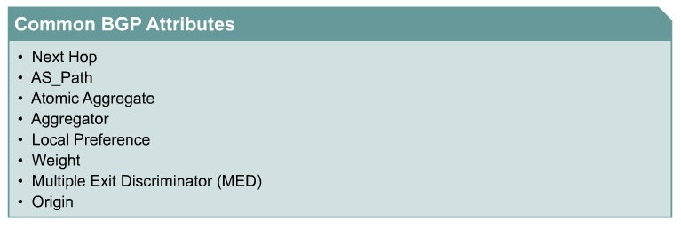
Implementing Policy
Traffic inside and outside an AS always flows according to the road map laid out by routes.
Altering the routes changes traffic behavior.
  How do I prevent my private networks from being advertised?
  How do I filter routing updates coming from a particular neighbor?
  How do I make sure that I use this link or this provider rather than another one?
Rick Graziani graziani@cabrillo.edu

Slide 3
Using BGP Attributes
When a BGP speaker receives updates from multiple autonomous systems that describe different paths to the same destination, it must choose the single best path for reaching that destination.
  Once chosen, BGP propagates the best path to its neighbors.
  The decision is based on the value of attributes (such as NEXT_HOP or LOCAL_PREF) that the update contains and other configurable BGP factors.
Rick Graziani graziani@cabrillo.edu

Slide 4
show ip bgp
To display entries in the BGP routing table, use the show ip bgp EXEC command.
show ip bgp [network] [network-mask] [longer-prefixes]
Let’s look at an example, but some of the options will be discussed later.
Rick Graziani graziani@cabrillo.edu

Slide 5
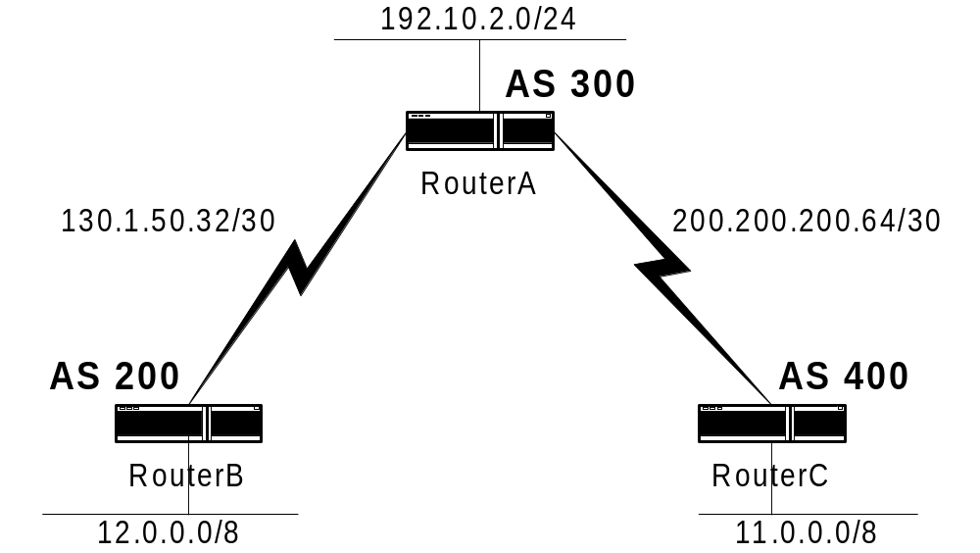
show ip bgp
RouterC#show ip bgp
BGP table version is 8, local router ID is 200.200.200.66
Status codes: s suppressed, d damped, h history, * valid, > best, i - internal
Origin codes: i - IGP, e - EGP, ? - incomplete
Network Next Hop Metric LocPrf Weight Path
*> 11.0.0.0 0.0.0.0 0 32768 i
*> 12.0.0.0 200.200.200.65 0 300 200 i
*> 192.10.2.0 200.200.200.65 0 0 300 i
Rick Graziani graziani@cabrillo.edu

Slide 6
show ip bgp
RouterC#show ip bgp
BGP table version is 8, local router ID is 200.200.200.66
Status codes: s suppressed, d damped, h history, * valid, > best, i - internal
Origin codes: i - IGP, e - EGP, ? - incomplete
Network Next Hop Metric LocPrf Weight Path
*> 11.0.0.0 0.0.0.0 0 32768 i
*> 12.0.0.0 200.200.200.65 0 300 200 i
*> 192.10.2.0 200.200.200.65 0 0 300 i
BGP table version - Internal version number of the table. This number is incremented whenever the table changes.
local router ID - IP address of the router.
Status codes - Status of the table entry. The status is displayed at the beginning of each line in the table. It can be one of the following values:
  s —The table entry is suppressed.
  * —The table entry is valid.
  > —The table entry is the best entry to use for that network.
  i —The table entry was learned via an internal BGP (iBGP) session
Rick Graziani graziani@cabrillo.edu

Slide 7
RouterC#show ip bgp
BGP table version is 8, local router ID is 200.200.200.66
Status codes: s suppressed, d damped, h history, * valid, > best, i - internal
Origin codes: i - IGP, e - EGP, ? - incomplete
Network Next Hop Metric LocPrf Weight Path
*> 11.0.0.0 0.0.0.0 0 32768 i
*> 12.0.0.0 200.200.200.65 0 300 200 i
*> 193.10.2.0 200.200.200.65 0 0 300 i
Origin codes - Origin of the entry. The origin code is placed at the end of each line in the table. It can be one of the following values:
  i —Entry originated from Interior Gateway Protocol (IGP) and was advertised with a network router configuration command.
  e —Entry originated from Exterior Gateway Protocol (EGP).
  ? —Origin of the path is not clear. Usually, this is a router that is redistributed into BGP from an IGP.
Network - IP address of a network entity.
Next Hop - IP address of the next system that is used when forwarding a packet to the destination network. An entry of 0.0.0.0 indicates that the router has some non-BGP routes to this network
Rick Graziani graziani@cabrillo.edu

Slide 8
RouterC#show ip bgp
BGP table version is 8, local router ID is 200.200.200.66
Status codes: s suppressed, d damped, h history, * valid, > best, i - internal
Origin codes: i - IGP, e - EGP, ? - incomplete
Network Next Hop Metric LocPrf Weight Path
*> 11.0.0.0 0.0.0.0 0 32768 i
*> 12.0.0.0 200.200.200.65 0 300 200 i
*> 193.10.2.0 200.200.200.65 0 0 300 i
Metric - If shown, the value of the interautonomous system metric.
LocPrf - Local preference value as set with the set local-preference route-map configuration command. The default value is 100.
Path - Autonomous system paths to the destination network. There can be one entry in this field for each autonomous system in the path.
Rick Graziani graziani@cabrillo.edu

Slide 9
BGP Attributes
ORIGIN
NEXT_HOP
AS_PATH
LOCAL_PREF
Weight
MULTI_EXIT_DISC (MED)
ATOMIC_AGGREGATE
NOTE: For several of these attributes, multiple options have been included in this presentation. Because of time and to make sure we first grasp the basic concepts, some of the options are added to the presentation for your own information and reference.
Rick Graziani graziani@cabrillo.edu

Slide 10
Path Attributes
Attribute Code
Type
1-ORIGIN
Well-known mandatory
2-AS_PATH
Well-known mandatory
3-NEXT_HOP
Well-known mandatory
4-MULTI_EXIT_DISC
Optional non-transitive
5-LOCAL_PREF
Well-known discretionary
6-ATOMIC_AGGREGATE
Well-known discretionary
7-AGGREGATOR
Well-known discretionary
8-COMMUNITY
Optional transitive (Cisco)
9-ORIGINATOR_ID
Optional non-transitive (Cisco)
10-Cluster List
Optional non-transitive (Cisco)
11-Destination Preference
(MCI)
12-Advertiser
(Baynet)
13-rcid_path
(Baynet)
255-Reserved
[md]
Rick Graziani graziani@cabrillo.edu

Slide 11
The ORIGIN attribute
Well-known mandatory attribute (type code 1)
Indicates the origin of the routing update
  IGP: The prefix is internal to the originating AS.
  EGP: The prefix was learned via some EGP, such as BGP.
  INCOMPLETE: The prefix was learned by some other means, probably redistribution.
BGP considers the ORIGIN attribute in its decision-making process to establish a preference ranking among multiple routes.
Specifically, BGP prefers the path with the lowest origin type, where
  IGP is lower than EGP
  and EGP is lower than INCOMPLETE.
Rick Graziani graziani@cabrillo.edu

Slide 12
The ORIGIN attribute
The origin attribute provides information about the origin of the route. The origin of a route can be one of three values:
IGP—The route is interior to the originating AS.
  This value is set when the network router configuration command is used to inject the route into BGP.
  The IGP origin type is represented by the letter i in the output of the show ip bgp EXEC command.
EGP—The route is learned via the Exterior Gateway Protocol (EGP).
  The EGP origin type is represented by the letter e in the output of the show ip bgp EXEC command.
Incomplete—The origin of the route is unknown or learned in some other way.
  An origin of Incomplete occurs when a route is redistributed into BGP.
  The Incomplete origin type is represented by the ? symbol in the output of the show ip bgp EXEC command
Rick Graziani graziani@cabrillo.edu

Slide 13
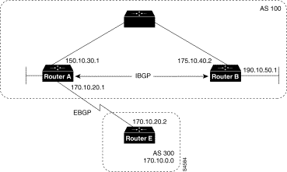
Router A
router bgp 100
neighbor 190.10.50.1 remote-as 100
neighbor 170.10.20.2 remote-as 300
network 150.10.0.0
redistribute static
ip route 190.10.0.0 255.255.0.0 null 0
Router B
router bgp 100
neighbor 150.10.30.1 remote-as 100
network 190.10.50.0
Router E
router bgp 300
neighbor 170.10.20.1 remote-as 100
network 170.10.0.0
Given these configurations, the following is true:
From Router A, the route for reaching 170.10.0.0 has an AS_path of 300 and an origin attribute of IGP.
From Router A, the route for reaching 190.10.50.0 has an empty AS_path (the route is in the same AS as Router A) and an origin attribute of IGP.
From Router E, the route for reaching 150.10.0.0 has an AS_path of 100 and an origin attribute of IGP.
From Router E, the route for reaching 190.10.0.0 has an AS_path of 100 and an origin attribute of Incomplete (because 190.10.0.0 is a redistributed route)
Rick Graziani graziani@cabrillo.edu

Slide 14
The ORIGIN attribute
Use a route map and the the set origin command to manipulate the ORIGIN attribute.
route-map SETORIGIN permit 10
set origin igp
Rick Graziani graziani@cabrillo.edu

Slide 15
Path Attributes
Attribute Code
Type
1-ORIGIN
Well-known mandatory
2-AS_PATH
Well-known mandatory
3-NEXT_HOP
Well-known mandatory
4-MULTI_EXIT_DISC
Optional non-transitive
5-LOCAL_PREF
Well-known discretionary
6-ATOMIC_AGGREGATE
Well-known discretionary
7-AGGREGATOR
Well-known discretionary
8-COMMUNITY
Optional transitive (Cisco)
9-ORIGINATOR_ID
Optional non-transitive (Cisco)
10-Cluster List
Optional non-transitive (Cisco)
11-Destination Preference
(MCI)
12-Advertiser
(Baynet)
13-rcid_path
(Baynet)
255-Reserved
[md]
Rick Graziani graziani@cabrillo.edu

Slide 16
NEXT_HOP
The NEXT_HOP attribute is a well-known mandatory attribute (type code 3).
In terms of an IGP, such as RIP, the “next hop” to reach a route is the IP address of the router that has announced the route.
  Note: The abbreviation IGP (Interior Gateway Protocol) will always be in green, so not to get it confused with IBGP (Interior BGP)
The NEXT_HOP concept with BGP is slightly more elaborate.
For EBGP sessions, the next hop is the IP address of the neighbor that announced the route
For IBGP sessions, for routes originated inside the AS, the next-hop is the IP address of the neighbor that announced the route.
For routes injected into the AS via EBGP, the next hop learned from EBGP is carried unaltered into IBGP.
  The next hop is the IP address of the EBGP neighbor from which the route was learned.
Rick Graziani graziani@cabrillo.edu

Slide 17
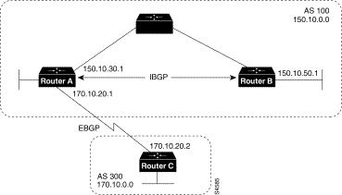
Router C advertises network 170.10.0.0 to Router A with a next hop attribute of 170.10.20.2, and Router A advertises network 150.10.0.0 to Router C with a next hop attribute of 170.10.20.1.
BGP specifies that the next hop of EBGP-learned routes should be carried without modification into IBGP.
Because of that rule, Router A advertises 170.10.0.0 to its IBGP peer (Router B) with a next hop attribute of 170.10.20.2.
As a result, according to Router B, the next hop to reach 170.10.0.0 is 170.10.20.2, instead of 150.10.30.1.
For that reason, the configuration must ensure that Router B can reach 170.10.20.2 via an IGP.
Otherwise, Router B will drop packets destined for 170.10.0.0 because the next hop address is inaccessible.
For example, if Router B runs IGRP, Router A should run IGRP on network 170.10.0.0.
You might want to make IGRP passive on the link to Router C so that only BGP updates are exchanged.
Router A
router bgp 100
neighbor 170.10.20.2 remote-as 300
neighbor 150.10.50.1 remote-as 100
network 150.10.0.0
Router B
router bgp 100
neighbor 150.10.30.1 remote-as 100
Router C
router bgp 300
neighbor 170.10.20.1 remote-as 100
network 170.10.0.0
Rick Graziani graziani@cabrillo.edu

Slide 18
Summarize
Router C advertises 170.10.0.0 to Router A with a next hop attribute of 170.10.20.2,
Router A advertises 170.10.0.0 to Router B with a next hop attribute of 170.10.20.2.
The next hop of EBGP-learned routes is passed to the IBGP neighbor without modification into IBGP.
Router A
router bgp 100
neighbor 170.10.20.2 remote-as 300
neighbor 150.10.50.1 remote-as 100
network 150.10.0.0
Router B
router bgp 100
neighbor 150.10.30.1 remote-as 100
Router C
router bgp 300
neighbor 170.10.20.1 remote-as 100
network 170.10.0.0
Rick Graziani graziani@cabrillo.edu

Slide 19
Path Attributes
Attribute Code
Type
1-ORIGIN
Well-known mandatory
2-AS_PATH
Well-known mandatory
3-NEXT_HOP
Well-known mandatory
4-MULTI_EXIT_DISC
Optional non-transitive
5-LOCAL_PREF
Well-known discretionary
6-ATOMIC_AGGREGATE
Well-known discretionary
7-AGGREGATOR
Well-known discretionary
8-COMMUNITY
Optional transitive (Cisco)
9-ORIGINATOR_ID
Optional non-transitive (Cisco)
10-Cluster List
Optional non-transitive (Cisco)
11-Destination Preference
(MCI)
12-Advertiser
(Baynet)
13-rcid_path
(Baynet)
255-Reserved
[md]
Rick Graziani graziani@cabrillo.edu

Slide 20
AS_PATH
An AS_PATH attribute is a well-known mandatory attribute (type code 2).
It is the sequence of AS numbers a route has traversed to reach a destination.
The AS that originates the route adds its own AS number when sending the route to its external BGP peers.
Thereafter, each AS that receives the route and passes it on to other BGP peers will prepend its own AS number to the list.
Prepending is the act of adding the AS number to the beginning of the list.
The final list represents all the AS numbers that a route has traversed with the AS number of the AS that originated the route all the way at the end of the list.
This type of AS_PATH list is called an AS_SEQUENCE, because all the AS numbers are ordered sequentially.
Rick Graziani graziani@cabrillo.edu

Slide 21
AS_PATH
RouterC#show ip bgp
BGP table version is 8, local router ID is 200.200.200.66
Status codes: s suppressed, d damped, h history, * valid, > best, i - internal
Origin codes: i - IGP, e - EGP, ? - incomplete
Network Next Hop Metric LocPrf Weight Path
*> 11.0.0.0 0.0.0.0 0 32768 i
*> 12.0.0.0 200.200.200.65 0 300 200 i
*> 192.10.2.0 200.200.200.65 0 0 300 i
Rick Graziani graziani@cabrillo.edu

Slide 22
AS_PATH – private AS numbers
BGP uses the AS_PATH attribute as part of the routing updates (UPDATE packet) to ensure a loop-free topology on the Internet.
Each route that gets passed between BGP peers will carry a list of all AS numbers that the route has already been through.
If the route is advertised to the AS that originated it, that AS will see itself as part of the AS_PATH attribute list and will not accept the route.
EBGP: BGP speakers prepend their AS numbers when advertising routing updates to other autonomous systems (external peers).
IBGP: When the route is passed to a BGP speaker within the same AS, the AS_PATH information is left intact.
Rick Graziani graziani@cabrillo.edu

Slide 23
AS_PATH – private AS numbers
AS_PATH information is one of the attributes BGP looks at to determine the best route to take to get to a destination.
  In comparing two or more different routes, given that all other attributes are identical, a shorter path is always preferred.
  In case of a tie in AS_PATH length, other attributes are used to make the decision. (later)
Private AS numbers cannot be leaked to the Internet because they are not unique.
  Cisco has implemented a feature, remove-private-as, to strip private AS numbers out of the AS_PATH list before the routes get propagated to the Internet.
Rick Graziani graziani@cabrillo.edu

Slide 24
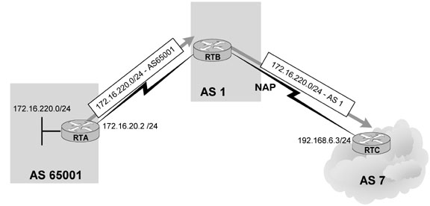
AS_PATH
AS1 is providing Internet connectivity to its customer AS 65001.
Because the customer connects to only this provider and no plans to connect to an additional provider in the near future, the customer has been allocated a private AS number.
BGP will strip private AS numbers only when propagating updates to the external peers.
This means that the AS stripping would be configured on RTB as part of its neighbor connection to RTC.
Rick Graziani graziani@cabrillo.edu

Slide 25
AS_PATH
Privately numbered autonomous systems should be connected only to a single provider.
If the AS_PATH contains a mixture of private and legal AS numbers, BGP will view this as an illegal design and will not strip the private AS numbers from the list, and the update will be treated as usual.
“If the AS_PATH includes both private and public AS numbers, BGP doesn't remove the private AS numbers. This situation is considered a configuration error.” Cisco
Only AS_PATH lists that contain private AS numbers in the range 64512 to 65535 are stripped.
Rick Graziani graziani@cabrillo.edu

Slide 26
AS_PATH
RTB(config)#router bgp 1
RTB(config-router)#neighbor 172.16.20.2 remote-as 65001
RTB(config-router)#neighbor 192.168.6.3 remote-as 7
RTB(config-router)#neighbor 192.168.6.3 remove-private-as
Note how RTB is using the remove-private-as keyword in its neighbor connection to AS7.
http://www.cisco.com/warp/public/459/32.html
Rick Graziani graziani@cabrillo.edu

Slide 27
AS_PATH - prepend
AS_PATH information is manipulated to affect interdomain routing behavior.
Because BGP prefers a shorter path over a longer one, system operators are tempted to change the path information by including dummy AS path numbers that would increase the path length and influence the traffic trajectory one way or the other.
Cisco's implementation enables a user to insert AS numbers at the beginning of an AS_PATH to make the path length longer.
Rick Graziani graziani@cabrillo.edu

Slide 28
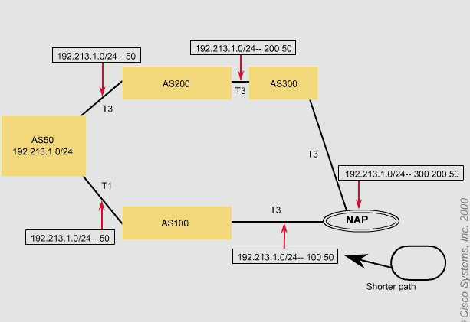
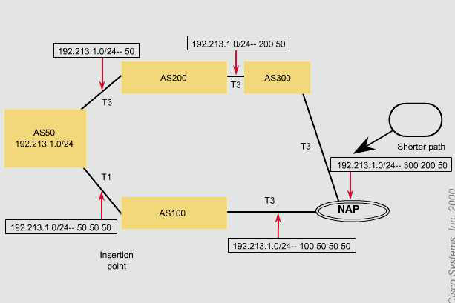
AS_PATH – prepend
Concept
New “shorter path”
Current “shorter path”
Rick Graziani graziani@cabrillo.edu

Slide 29
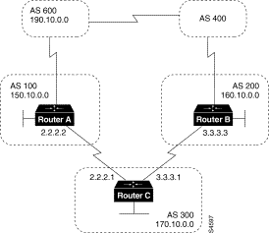
AS_PATH – prepend - Example
Router C
router bgp 300
network 170.10.0.0
neighbor 3.3.3.3 remote-as 200
neighbor 2.2.2.2 remote-as 100
neighbor 2.2.2.2 route-map SETPATH out
route-map SETPATH permit 10
set as-path prepend 300 300
route-map
If you want to use the configuration of Router C to influence the choice of paths in AS 600, you can do so by prepending extra AS numbers to the AS_path attribute for routes that Router C advertises to AS 100.
A common practice is to repeat the AS number, as in the above configuration.
The set as-path route map configuration command with the prepend keyword causes Router C to prepend 300 twice to the value of the AS_path attribute before it sends updates to the neighbor at IP address 2.2.2.2 (Router A).
As a result, the AS_path attribute of updates for network 170.10.0.0 that AS 600 receives via AS 100 will be 100, 300, 300, 300, which is longer than the value of the AS_path attribute of updates for network 170.10.0.0 that AS 600 receives via AS 400 (400, 200, 300).
AS 600 will choose (400, 200, 300) as the better path.
Rick Graziani graziani@cabrillo.edu

Slide 30
Path Attributes
Attribute Code
Type
1-ORIGIN
Well-known mandatory
2-AS_PATH
Well-known mandatory
3-NEXT_HOP
Well-known mandatory
4-MULTI_EXIT_DISC
Optional non-transitive
5-LOCAL_PREF
Well-known discretionary
6-ATOMIC_AGGREGATE
Well-known discretionary
7-AGGREGATOR
Well-known discretionary
8-COMMUNITY
Optional transitive (Cisco)
9-ORIGINATOR_ID
Optional non-transitive (Cisco)
10-Cluster List
Optional non-transitive (Cisco)
11-Destination Preference
(MCI)
12-Advertiser
(Baynet)
13-rcid_path
(Baynet)
255-Reserved
[md]
Rick Graziani graziani@cabrillo.edu

Slide 31
The LOCAL_PREF Attribute
Well-known discretionary attribute (type code 5).
Degree of preference given to a route to compare it with other routes for the same destination
  Higher LOCAL_PREF values are preferred
Local to the AS
  Exchanged between IBGP peers only
  It is not advertised to EBGP peers
Routers within a multi-homed AS may learn that they can reach the same destination network via neighbors in two (or more) different autonomous systems.
  There could be two or more exit points from the local AS to any given destination.
You can use the LOCAL_PREF attribute to force your BGP routers to prefer one exit point over another when routing to a particular destination network.
Rick Graziani graziani@cabrillo.edu

Slide 32
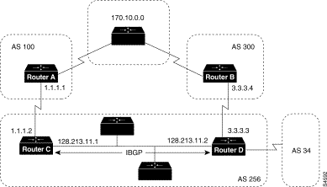
The LOCAL_PREF Attribute
Which exit should all the routers within AS 256 use?
?
?
Because this attribute is communicated within all BGP routers inside the AS, all BGP routers will have a common view on how to exit the AS.
Although routers always prefer the lowest-route metric and administrative distance for a given destination, BGP routers prefer higher LOCAL_PREF values over lower ones.
When there are multiple paths to the same destination, the local preference attribute indicates the preferred path.
The path with the higher preference is preferred (the default value of the local preference attribute is 100).
Unlike the weight attribute, which is only relevant to the local router, the local preference attribute is part of the routing update and is exchanged among routers in the same AS.
Rick Graziani graziani@cabrillo.edu

Slide 33
AS 256 receives route updates for network 170.10.0.0 from AS 100 and AS 300.
There are two ways to set local preference:
  Using the bgp default local-preference command
  Using a Route Map to Set Local Preference
Rick Graziani graziani@cabrillo.edu

Slide 34
Higher Local Preference is preferred!
150
200
Using the bgp default local-preference Command
The following configurations use the bgp default local-preference router configuration command to set the local preference attribute on Routers C and D:
Router C
router bgp 256
neighbor 1.1.1.1 remote-as 100
neighbor 128.213.11.2 remote-as 256
bgp default local-preference 150
Router D
router bgp 256
neighbor 3.3.3.4 remote-as 300
neighbor 128.213.11.1 remote-as 256
bgp default local-preference 200
Higher Local Preference is preferred!
Rick Graziani graziani@cabrillo.edu

Slide 35
All traffic in AS 256 destined for 170.10.0.0 (and other ASes)
Local Pref = 150
Local Pref = 200
Router C
router bgp 256
bgp default local-preference 150
Router D
router bgp 256
bgp default local-preference 200
The configuration for Router C causes it to set the local preference of all updates from AS 300 to 150 (routes learned from RouterD), and the configuration for Router D causes it to set the local preference for all updates from AS 100 to 200 (routes learned from RouterC).
Because local preference is exchanged within the AS, both Routers C and D determine that updates regarding network 170.10.0.0 have a higher local preference when they come from AS 300 than when they come from AS 100.
As a result, all traffic in AS 256 destined for network 170.10.0.0 is sent to Router D as the exit point.
Higher Local Preference is preferred!
Rick Graziani graziani@cabrillo.edu

Slide 36
Higher Local Preference is preferred!
All traffic in AS 256 destined for 170.10.0.0 (and other AS’s)
Local Pref = 150
Local Pref = 200
Using a Route Map to Set Local Preference - FYI
Route maps provide more flexibility than the bgp default local-preference router configuration command.
When the bgp default local-preference command is used on Router D, the local preference attribute of all updates received by Router D will be set to 200, including updates from AS 34.
Rick Graziani graziani@cabrillo.edu

Slide 37
Higher Local Preference is preferred!
All traffic in AS 256 destined for 170.10.0.0 (and other AS’s)
Local Pref = 150
Local Pref = 200
The following configuration uses a route map to set the local preference attribute on Router D specifically for updates regarding AS 300:
Router D
router bgp 256
neighbor 3.3.3.4 remote-as 300
route-map SETLOCALIN in
neighbor 128.213.11.1 remote-as 256
route-map SETLOCALIN permit 10
set local-preference 200
route-map SETLOCALIN permit 20
With this configuration, the local preference attribute of any update coming from AS 300 is set to 200.
Instance 20 of the SETLOCALIN route map accepts all other routes.
Rick Graziani graziani@cabrillo.edu

Slide 38
Summary of the BGP Path Selection Process
BGP selects only one path as the best path.
When the path is selected, BGP puts the selected path in its routing table and propagates the path to its neighbors.
BGP uses the following criteria, in the order presented, to select a path for a destination:
1. If the path specifies a next hop that is inaccessible, drop the update.
2. Prefer the path with the largest weight.
3. If the weights are the same, prefer the path with the largest local preference.
4. If the local preferences are the same, prefer the path that was originated by BGP running on this router.
5. If no route was originated, prefer the route that has the shortest AS_path.
6. If all paths have the same AS_path length, prefer the path with the lowest origin type (where IGP is lower than EGP, and EGP is lower than Incomplete).
7. If the origin codes are the same, prefer the path with the lowest MED attribute.
8. If the paths have the same MED, prefer the external path over the internal path.
9. If the paths are still the same, prefer the path through the closest IGP neighbor.
10. Prefer the path with the lowest IP address, as specified by the BGP router ID.
Rick Graziani graziani@cabrillo.edu

